Slide 1
PR-report 23rd Azerbaijan International Construction Exhibition 10th Anniversary International Exhibition for Heating, Ventilation, Air-Conditioning, Water Supply, Sanitary, Environmental Technology, Swimming Pool and Renewable Energies and 10th Anniversary Caspian International Protection, Security and Rescue Exhibition
Prepared by PR-assistant
Shovkat Hasanova

Slide 2
PR report
Press Conference
Media Monitoring
Newspapers
Opening Ceremony
Magazines
TV
Internet Portals
Radio
Business Breakfast

Slide 3
Statistics
Of the WorldBuild Baku, Aquatherm Baku and Securika Caspian :
55 articles were published in 15 Newspapers and 18 Magazines
340 news were published in 65 Internet Portals
7 TV channels showed the video about the exhibitions 25 times in daily news
1 Radio channels voiced advertising 2 times

Slide 4
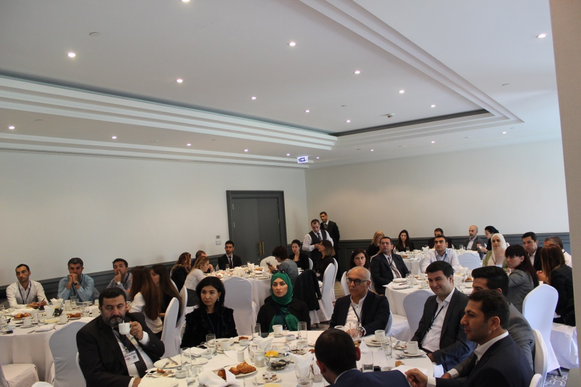
Business Breakfast
The business breakfast hosted by the organisers, which took place long before the actual opening of the exhibitions, on September 26. The aim of this business breakfast was to help the participants to take better advantage of the opportunities which the exhibitions present. The event was attended by exhibitors of exhibitions and the organiser’s team. The business breakfast was led by a professional coach from the Big City Coaching Company, Ksenika Borisova, who was specially invited by the Organisers. During the breakfast, the main issues relating to stand organisation were touched upon, and a formula for successful participation at the exhibitions was presented. The coach emphasized the importance of maximizing the use of all the available resources at the exhibitions to establish contacts, and also catalogued the free resources that the organisers offer before, during and after the exhibitions. Besides having organised a business breakfast, the Organisers provided the participants with an opportunity to get acquainted, which many of them would otherwise not have had due to the fact of their working in their respective stands during the exhibition, although they are potential clients of each other’s businesses.

Slide 5
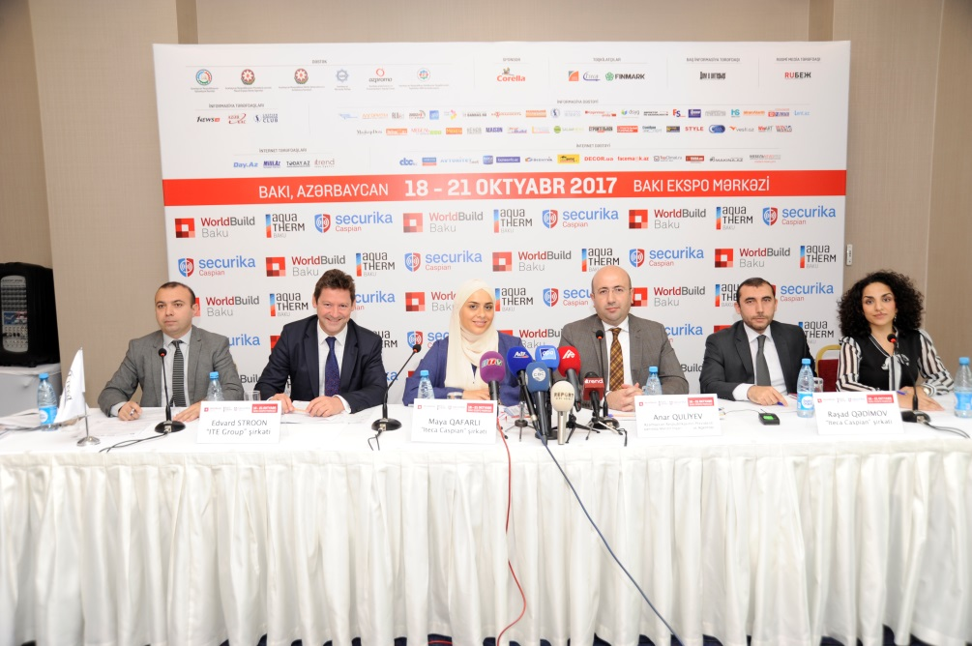
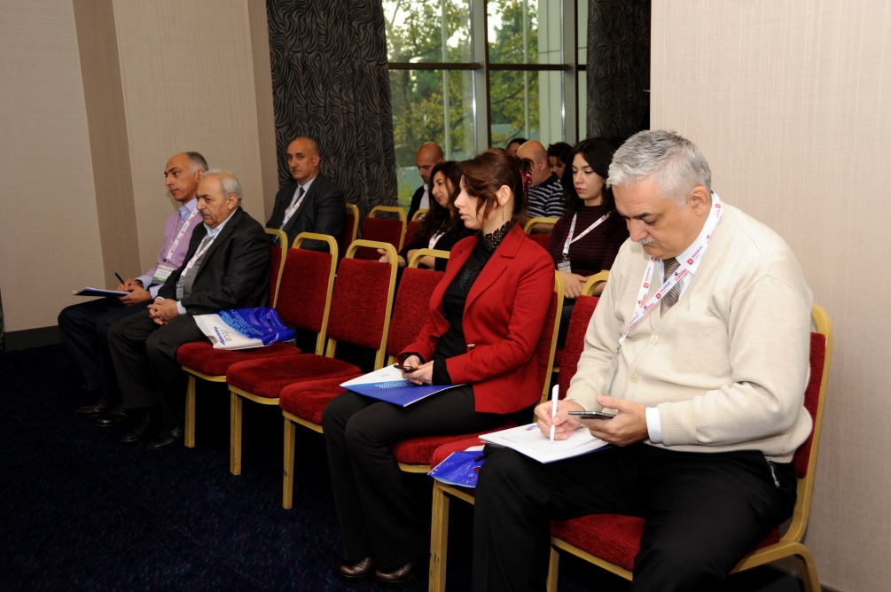
Press Conference
The press conference dedicated to the opening of the 23rd Azerbaijan International Construction, 10th Anniversary International Exhibition for Heating, Ventilation, Air-Conditioning, Water Supply, Sanitary, Environmental Technology, Swimming Pool and Renewable Energies and 10th Anniversary Caspian International Protection, Security and Rescue Exhibitions was on 17 October at 12:00 a.m. at the Park Inn Hotel, Nasimi meeting room.
The press conference was attended by Mr. Anar Guliyev - Head of Staff of State Housing Development Agency under the President of the Republic of Azerbaijan, Mr. Edward Strachan - Regional Director of ITE Group, Mrs. Maya Gafarli - Project Manager of WorldBuild Baku and Mr. Rashad Gadimov - Project Manager of Aquqtherm Baku and Securika Caspian.
More than 20 media attended the press-conference from AzTv, APA, Azertag, CBC, ITV, Interfax, Vestnik Kavkaza, Report, TREND and other agencies. During the press conference, journalists were informed about the participants, the record-breaking statistics of the exhibition.

Slide 6
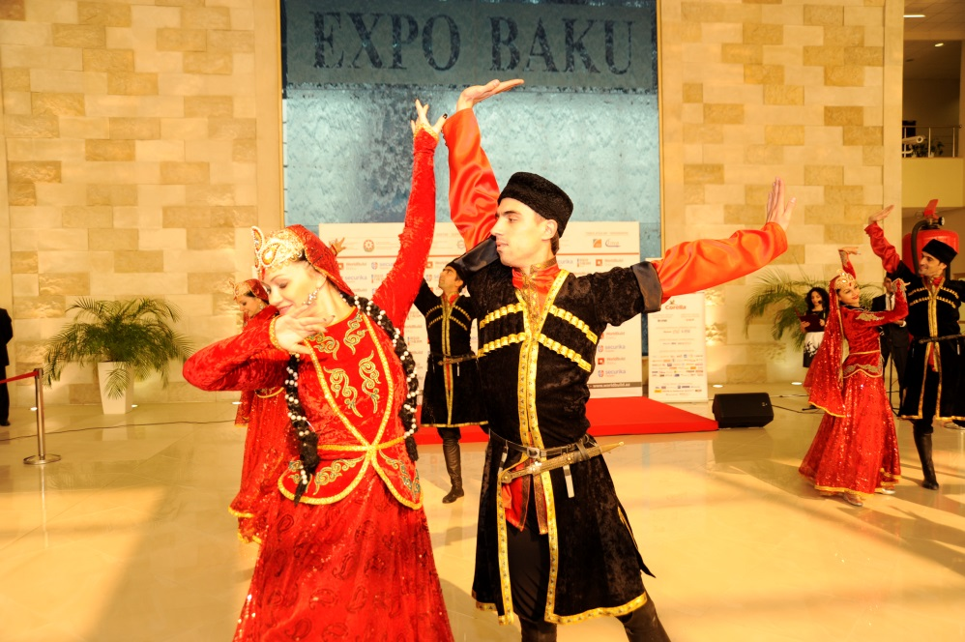
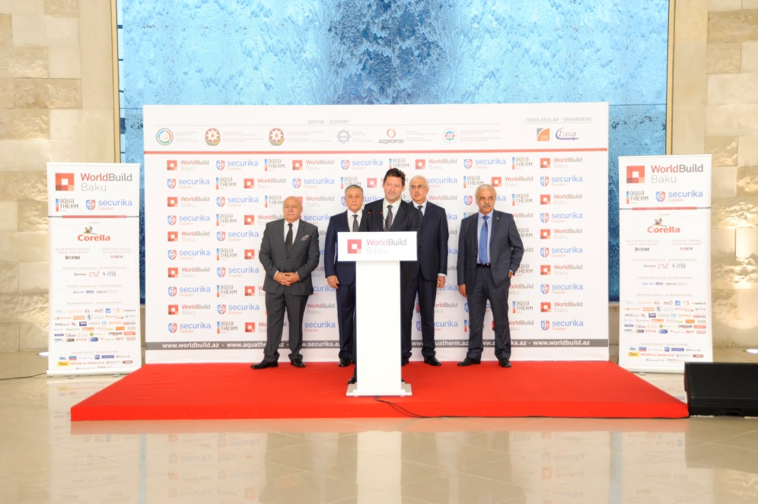
Opening Ceremony
The opening ceremony of the WorldBuild Baku, Aquatherm Baku and Securika Caspian exhibitions was held on October 18th at 10:00 in Baku Expo Center.
The official opening ceremony of the exhibitions took place with participation of:
The official opening ceremony was attended by Mr. Niyazi Safarov, Deputy Minister of Economy of the Republic of Azerbaijan, Mr. Sadig Sadigov, Deputy Director of the State Housing Development Agency under the President of the Republic of Azerbaijan, Mr. Elkhan Asadov - Deputy Chief of State Agency on Construction Safety Control of Ministry of Emergency Situations of the Republic of Azerbaijan, Mr. Elbay Qasimzade, Chairman of the Union of Architects of Azerbaijan, Mr. Edward Strachan – Regional Director of ITE Group Plc.

Slide 7
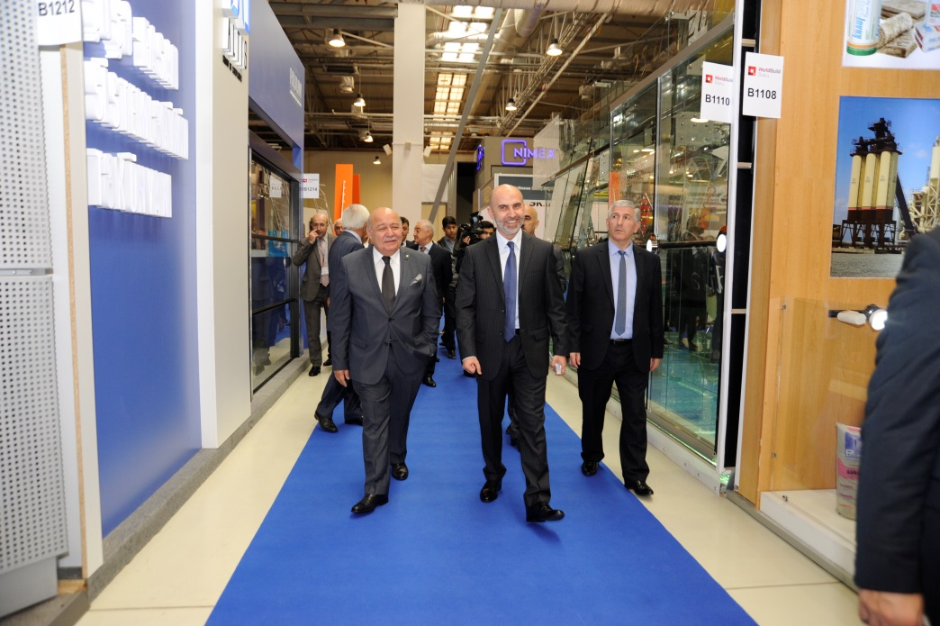
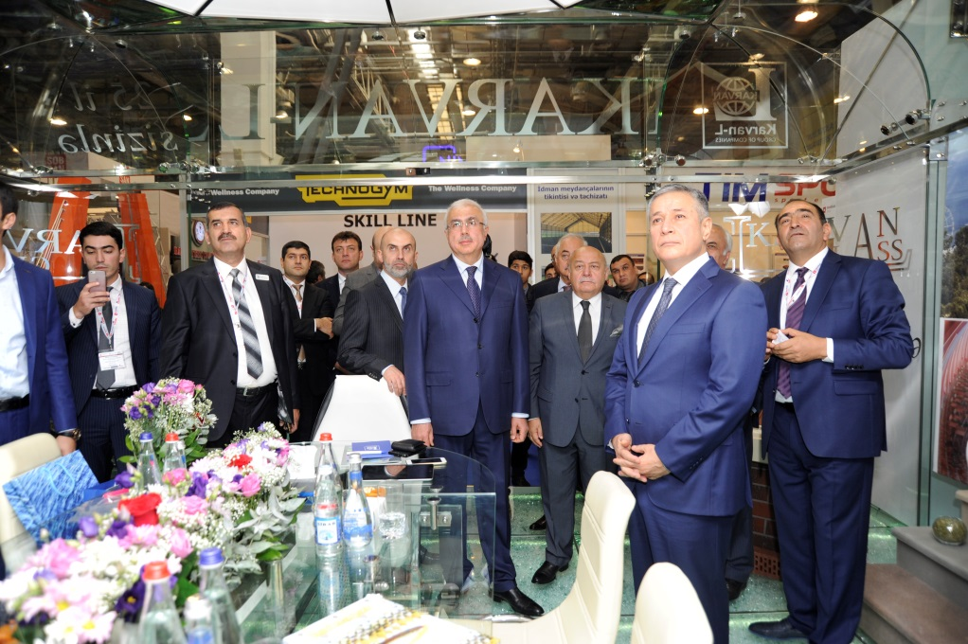
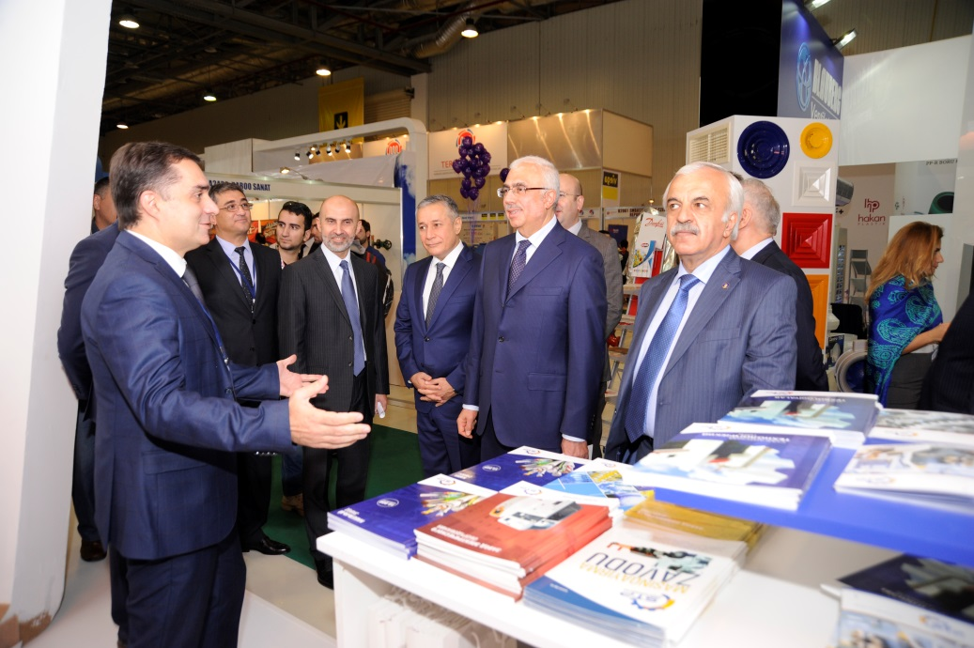
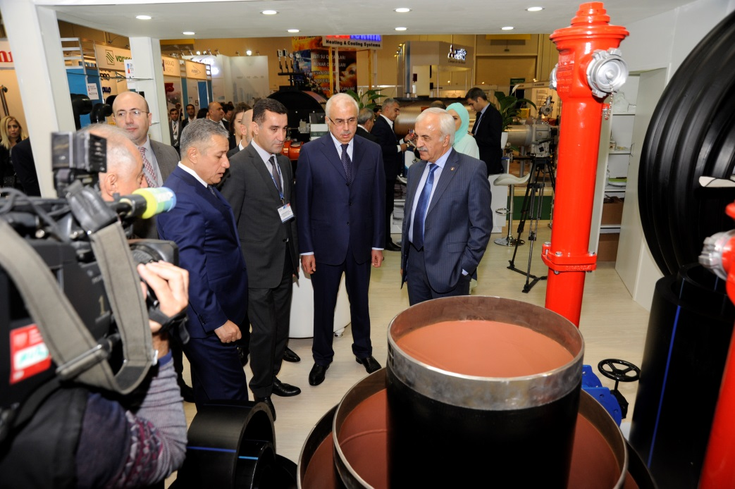

Slide 8
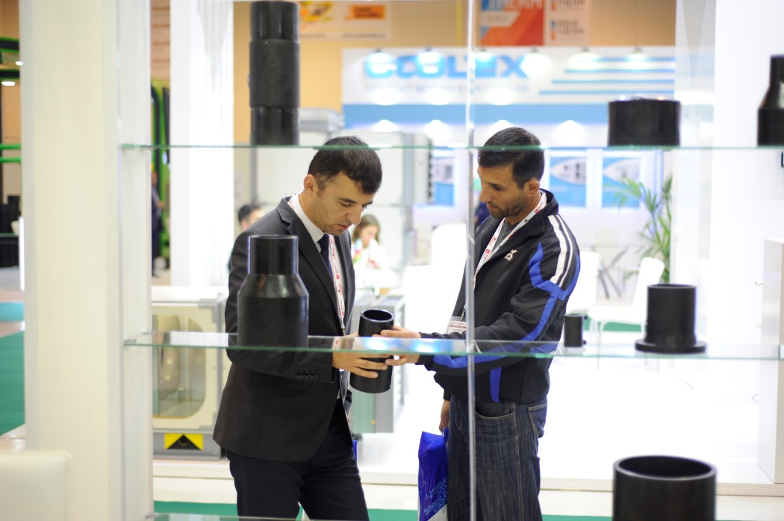
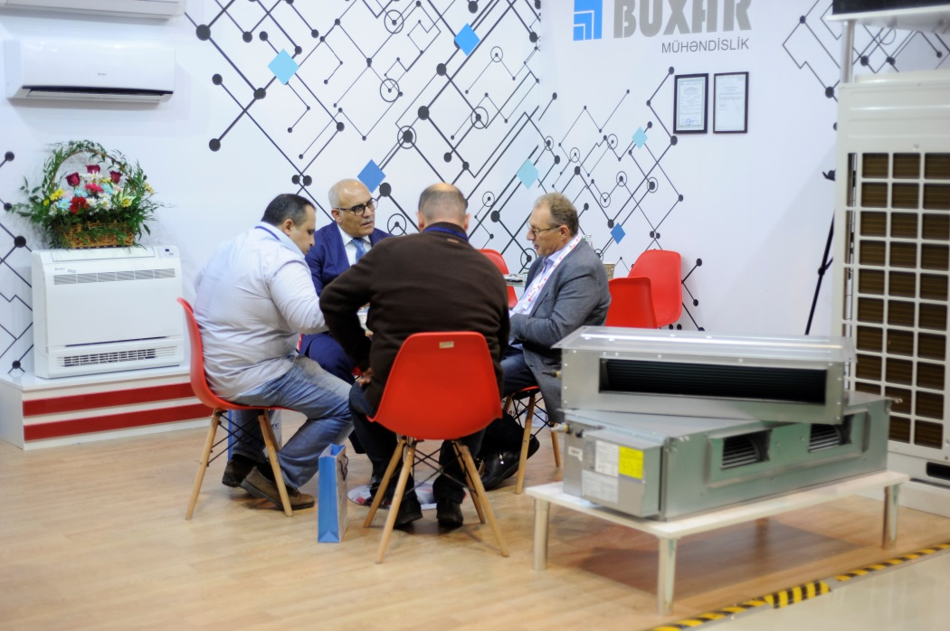
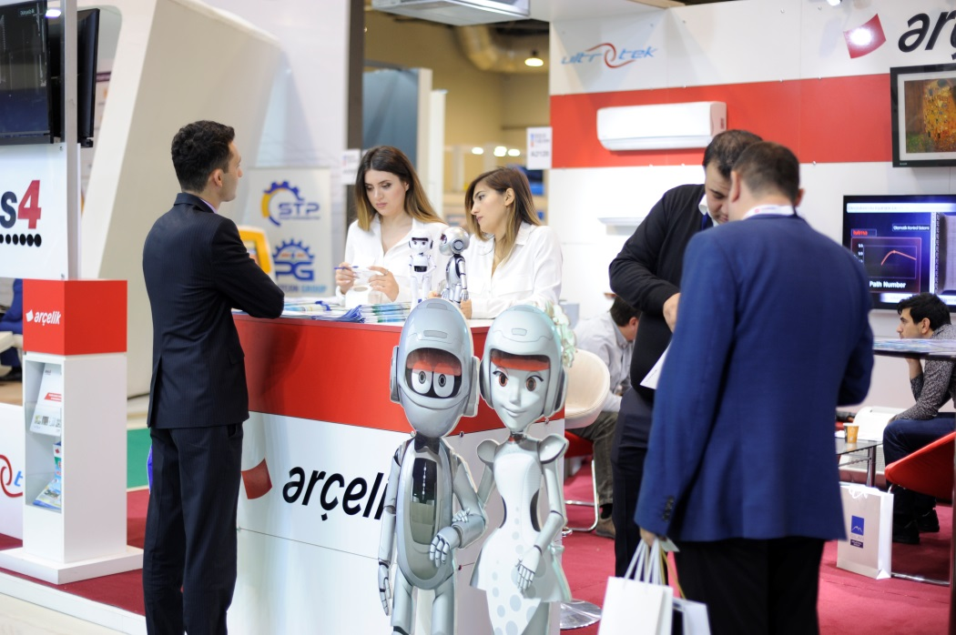
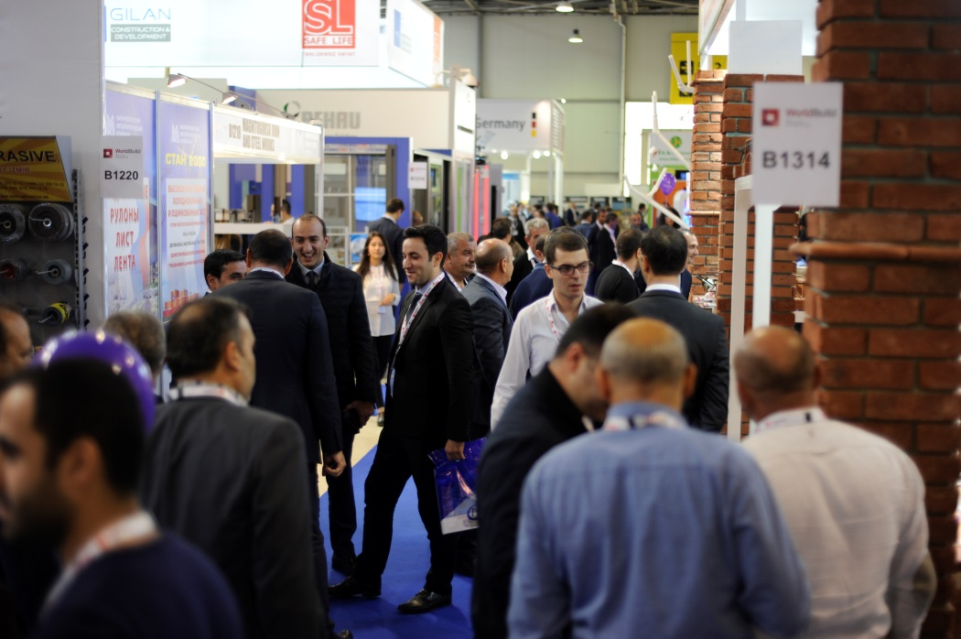

Slide 9
Media Monitoring

Slide 10
Newspapers
525-ci qazet
Azerbaycanskiye Izvestiya
Bizim Yol
Ejednevniue Novosti
Exo
Hefte ichi
Iki sahil
Kaspi
Palitra
Respublika
Uc noqte
Xalq cebhesi
Vishka
Vergiler

Slide 11
Magazine
Alqoritm Bezopasnosti
AzerNews
Azeri Observer
Aqua Park
Banbas
Budivelniy journal
Bezopasnost
Consulting and Business
Dom i Interyer
Havuz & Sauna
Inshaat & Yatirim
F+S
Memar
Prof Build
Santexnika
Style-Architecture Interior Design
World Economics

Slide 12
TV monitoring
Date | Time | Channels
17.10.2017 | 14:00 | CBC
17.10.2017 | 17:22 | CBC
17.10.2017 | 17:22 | ITV
17.10.2017 | 17:35 | AzTV
18.10.2017 | 13:00 | CBC
18.10.2017 | 17:33 | ITV
18.10.2017 | 18:02 | CBC
18.10.2017 | 19:03 | Lider
18.10.2017 | 20:50 | AzTV
18.10.2017 | 20:55 | ATV
18.10.2017 | 21:12 | ITV
18.10.2017 | 21:41 | Xezer
18.10.2017 | 21:42 | Xezer
19.10.2017 | 12:00 | CBC
19.10.2017 | 16:00 | ARB
19.10.2017 | 18:10 | CBC
19.10.2017 | 20:44 | AzTV
19.10.2017 | 20:58 | ITV
19.10.2017 | 21:36 | Xezer
19.10.2017 | 21:39 | Xezer
20.10.2017 | 08:30 | AzTV
20.10.2017 | 12:00 | CBC
20.10.2017 | 21:07 | ITV
21.10.2017 | 20:58 | ITV
21.10.2017 | 21:00 | AzTV

Slide 13
Radio Monitoring
Date | Time | Radio Station
18.10.2017 | 10:00 | Burc FM

Slide 14
Watch us on YouTube channel:
https://www.youtube.com/user/ItecaCaspian/

Slide 15
Total number of WorldBuild Baku 8 556
Total number of Aquatherm Baku 1 700
Total number of Securika Caspian 1 730

Slide 16
Internet portals
http://marja.az/news/12798?title=biznesin-inkisaf-etdirilmesi-ucun-novbeti-furset-18-21-oktyabrda-kecirilecek
http://salamnews.org/ru/news/read/287249
http://salamnews.org/az/news/read/287820
http://azertag.az/ru/xeber/V_Baku_sostoitsya_yubileinaya_Mezhdunarodnaya_vystavka_Aquatherm_Baku_2017-1092722
https://news.milli.az/exibitions/580328.html
https://news.day.az/economy/931134.html
http://azertag.az/xeber/Bu_il_Bakida_daha_bir_sergi_oz_yubileyini_qeyd_edecek-1092707
http://report.az/ru/turizm-i-vystavki/v-oktyabre-projdet-mezhdunarodnaya-vystavka-aquatherm-baku-2017/
http://hafta.az/index2.php?m=yazi&id=205557
http://www.caspianenergy.net/en/infrastructure/42977-10th-anniversary-international-exhibition
http://www.caspianenergy.net/ru/infrastruktura/42978-10th-anniversary-international-exhibition
http://metbuat.az/news/789113/oktyabrda-aquatherm-baku-2017-beynelxalq-sergisi-kecirilecek.html
http://abc.az/eng/news_12_09_2017_105535.html
http://www.abc.az/news_12_09_2017_105535.html
http://www.azadliq.az/xeber/178356/oktyabrda-aquatherm-baku-2017-beynelxalq-sergisi-kecirilecek/
http://cia.az/news-view/76159-Aquatherm-Baku-2017-sergisi-kechirilecek
http://son.az/az/news/264529/oktyabrda-aquatherm-baku-2017-beynelxalq-sergisi-kecirilecek
http://report.az/turizm-ve-sergiler/oktyabrda-aquatherm-baku-2017-beynelxalq-sergisi-kecirilecek/
http://son.az/az/news/264515/aquatherm-baku-2017-sergisi-kecirilecek
https://az.trend.az/business/2795520.html
Total: 340 articles

Slide 17
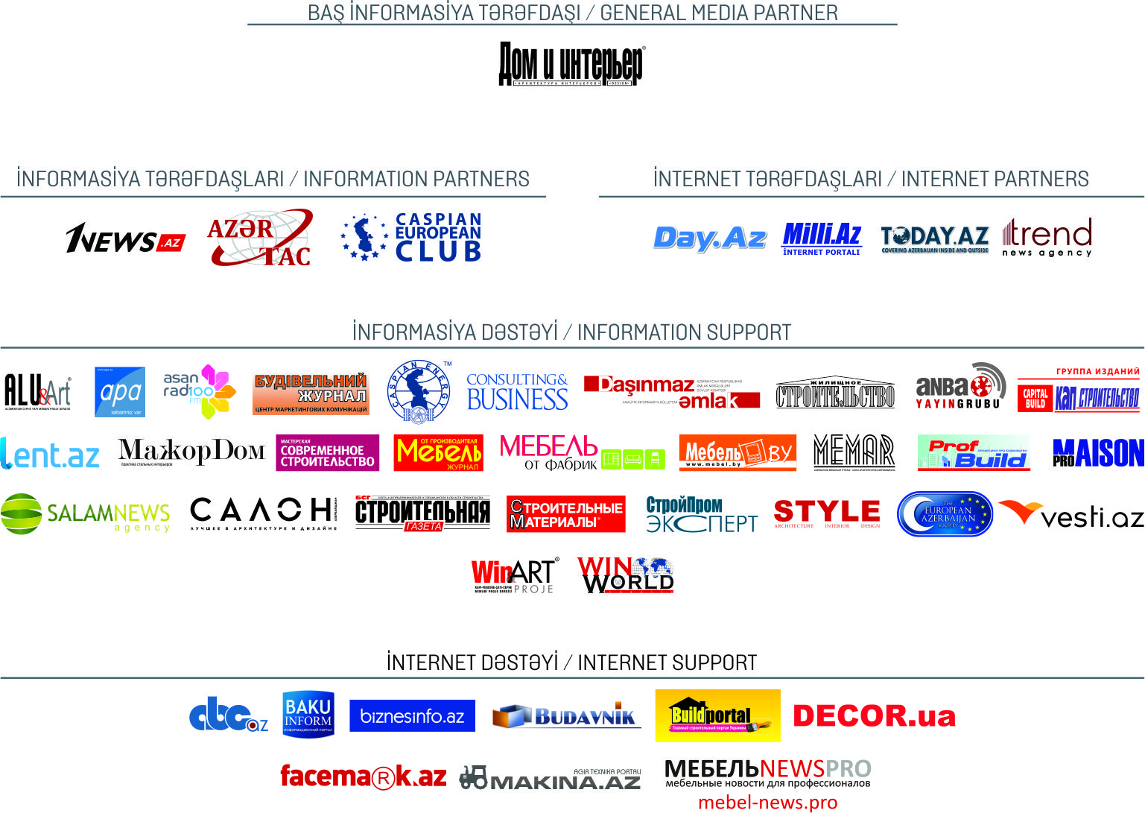

Slide 18
See you in 2018!

